Slide 1

Customer buying behaviour analysis
16th July 2023

Slide 2
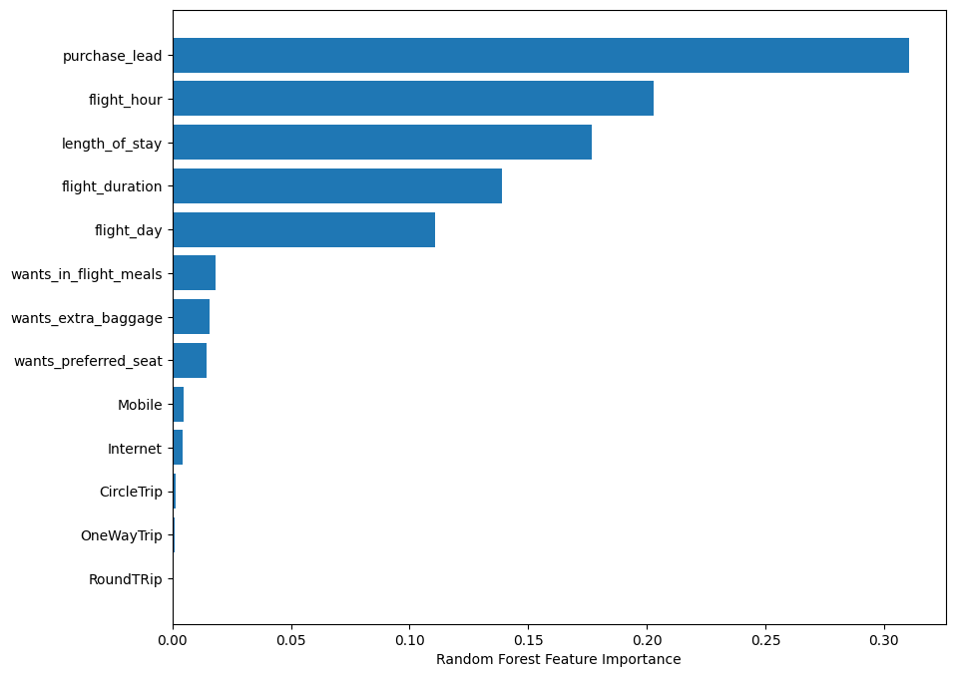
Data analysis & Prediction
The key variable that drove the model's predictions was "purchase_lead," representing the time between purchase and departure. Flight-related details, such as flight time and duration, also played a significant role.
The model demonstrated strong performance with an accuracy of 93.26% on the training data and 85.33% on the test data. Additionally, the AUC score, a measure of model performance, reached 99.90% on the training data and 64.82% on the test data.
These results indicate the model's effectiveness in capturing patterns and making accurate predictions.
16th July 2023

